Slide 1

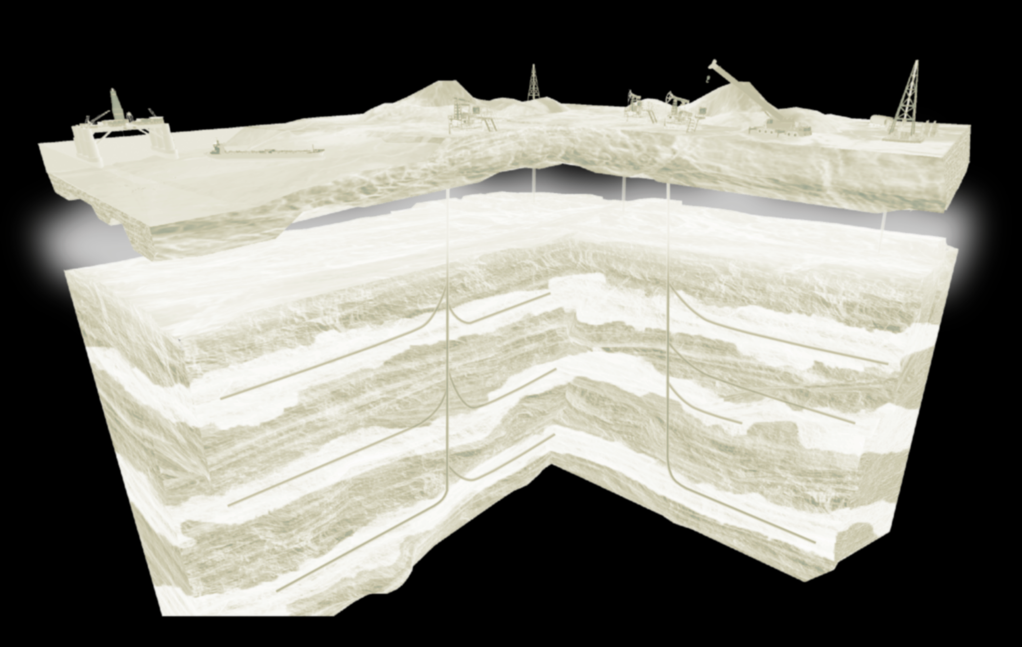


Immersive Learning
in Petroleum Asset Management
and Petroleum Engineering

Slide 2





CONCEPT
WE TRAIN ROBOTS
AND ROBOTS TRAIN PEOPLE!
What is this
PetroCup is an on-line interactive training and testing program in various Upstream activities, including exploration, field development planning and well & reservoir management.
It's powered by the PolyPlan software which implements a digital twin of synthetic petroleum assets so that a professional petroleum asset team can go through many years of field exploration and production in just a few days or a few weeks and learn a lot of practical lessons in key petroleum disciplines, cross-discipline interaction and asset management.
2

Slide 3

APPLICATION
Why doing this
Team-training for Asset Management
Cross-discipline training
Practical training for young specialists
Certification/Testing
Corporate championship
Cross-corporate competition
3

Slide 4
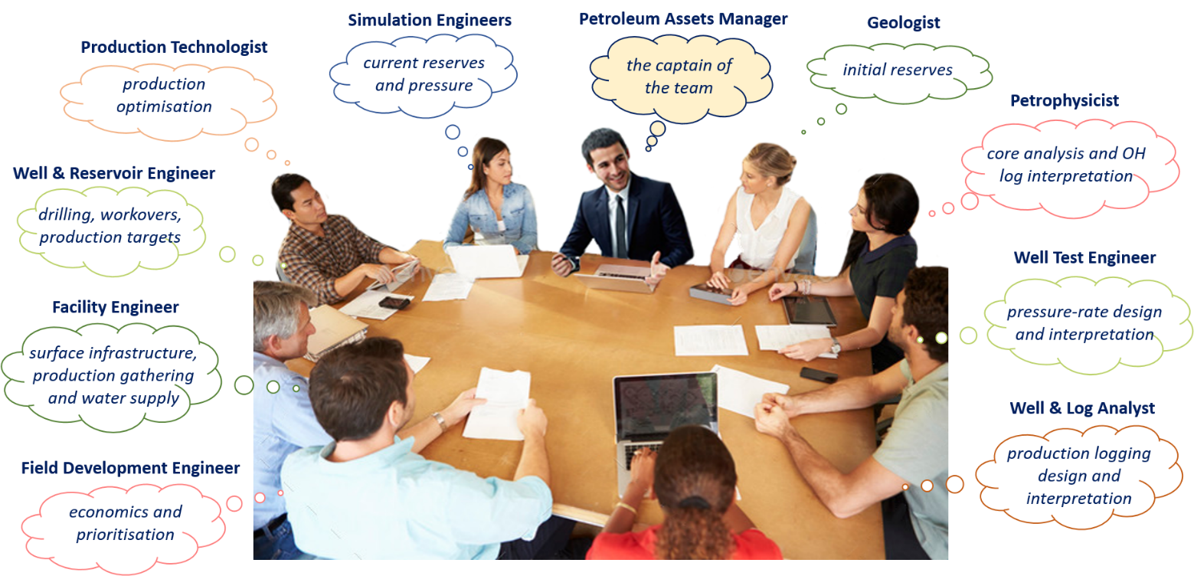
TARGET AUDIENCE
Who needs this
Assets Manager (the captain of the team)
Economics & Procurement engineer (economics and prioritisation)
Facility Engineer (surface infrastructure, production gathering and water supply)
Well & Reservoir Engineer (drilling, workovers, production targets)
Production Technologist (production optimisation)
Simulation Engineer (current reserves and pressure)
Geologist (initial reserves)
Petrophysicist (core analysis and OH log interpretation)
Well Test Engineer (pressure-rate design and interpretation)
Well & Log Analyst (production logging design and interpretation)
4

Slide 5
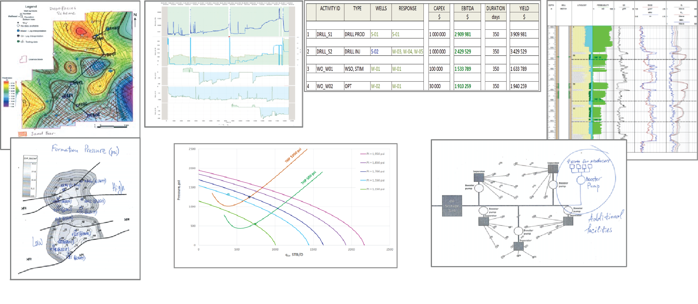
SKILLS
What is required and acquired
Investment Project Economics
Exploration
Field Surveillance
Seismic Analysis
Open-Hole Log Analysis
Cased-Hole Log Analysis
Pressure/Rate Transient Analysis
G&G Data Analysis
Booking Reserves
Field Development Planning
Designing & Optimising
Surface Facilities
Drilling, Workovers, Fracturing
Production Optimisation
Field Studies
Nodal Analysis
Well Performance Analysis
Localising reserves opportunities
Identifying pressure support opportunities
Assessing reservoir properties
Material balance analysis
Cross-well connectivity
5

Slide 6
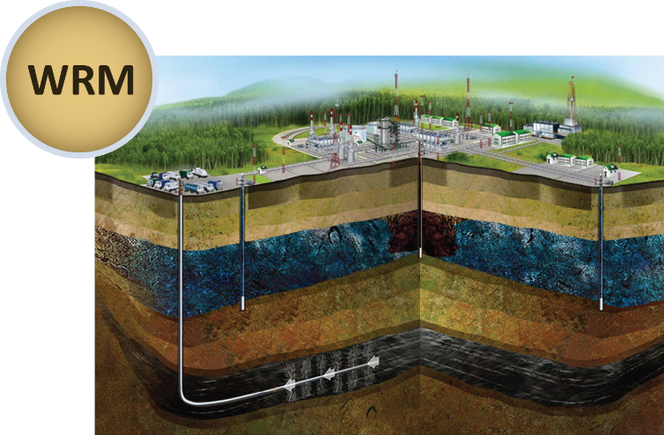
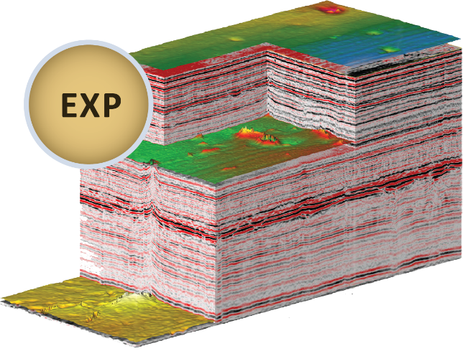
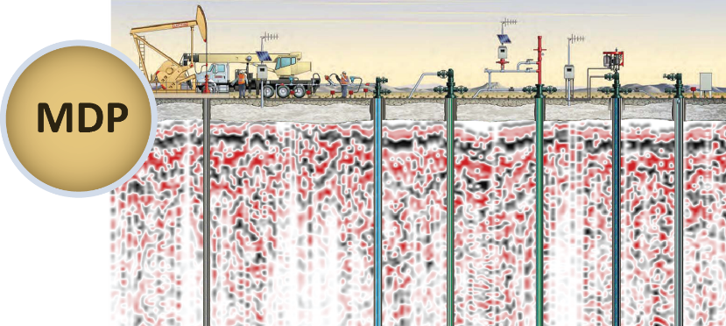
SESSION FORMAT
Engineering Domains
Petrocup WRM sets a focus on training/testing in well and reservoir management of the brown and mature fields
Petrocup MDP sets a focus on training/testing in the master development planning of a newly explored field based on G&G data, Reserves Booking and a few years of trial production
Petrocup EXP sets a focus on training/testing in hydrocarbon exploration, petroleum geology, petrophysics and the reserves booking
6

Slide 7
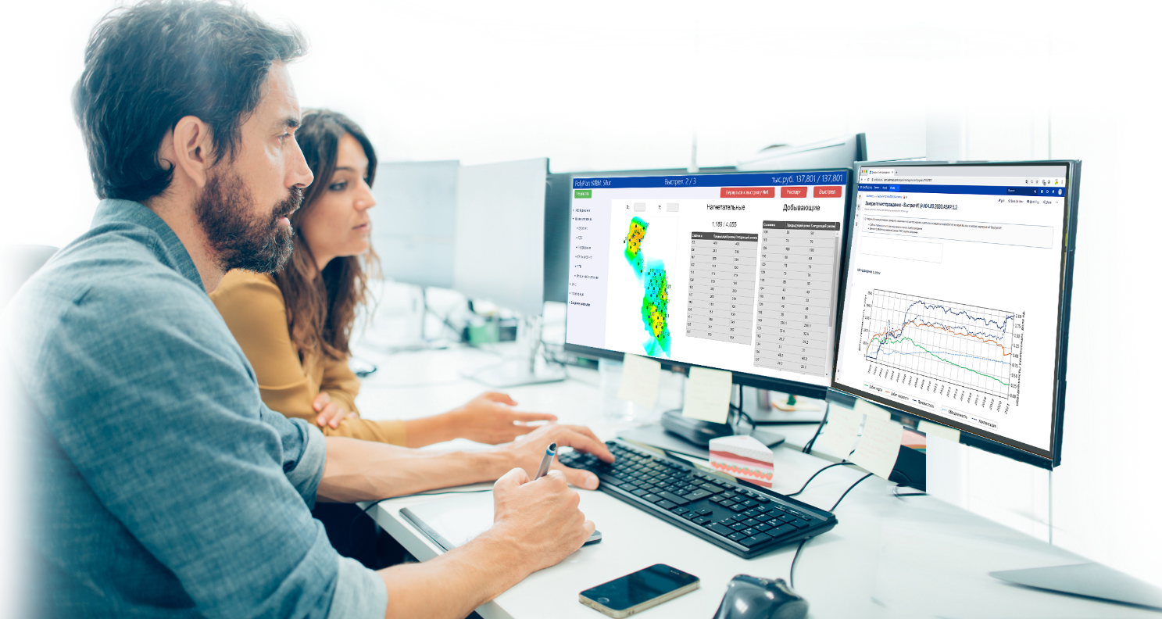
SESSION FORMAT
Practicum
Practicum is a one-day on-line stand-alone PetroCup session where user can place shots at will, monitor the performance metrics in real-time, rewind back to previous Shot and try different field operations or restart the session anew. In other words a user rents the PetroCup engine for the whole day with the full access to Debriefing metrics.
The Practicum session is fully automated and does not involve Nafta College specialists.
A user can go through the Practicum session alone or make up a team.
It provides an excellent experience in corresponding domains (MDP, WRM or G&G) and prepares a user or a team for the PetroCup Tournaments and PetroCup Certification.
7

Slide 8
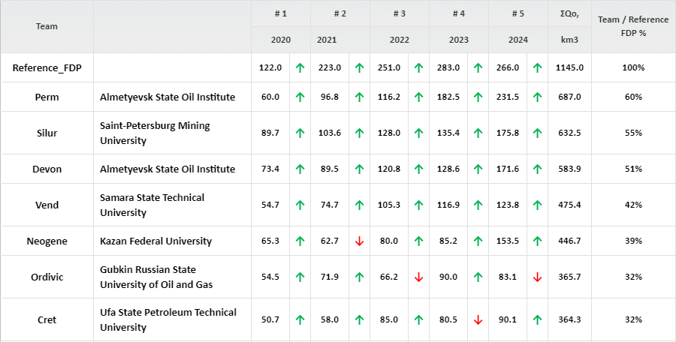
SESSION FORMAT
Tournament
Tournament is a multi-team competition with the limited time frame for each Shot (usually one or
few hours). It starts with introduction to PetroCup regulations, followed by detailing of the current Session specifics. The Tournament may last one or few days and consists of several Shots (usually from 3 to 10) each of them representing a one year production period of synthetic field.
The Tournament Standings are available to all teams after each Shot thus manifesting the progress of each team in terms of Net Present Value of the gross Asset Profit and instigating the further competition. After the Tournament the Session Moderator performs a Debriefing on teams' performance and eventually proceeds into
a Winner Award Ceremony.
8

Slide 9
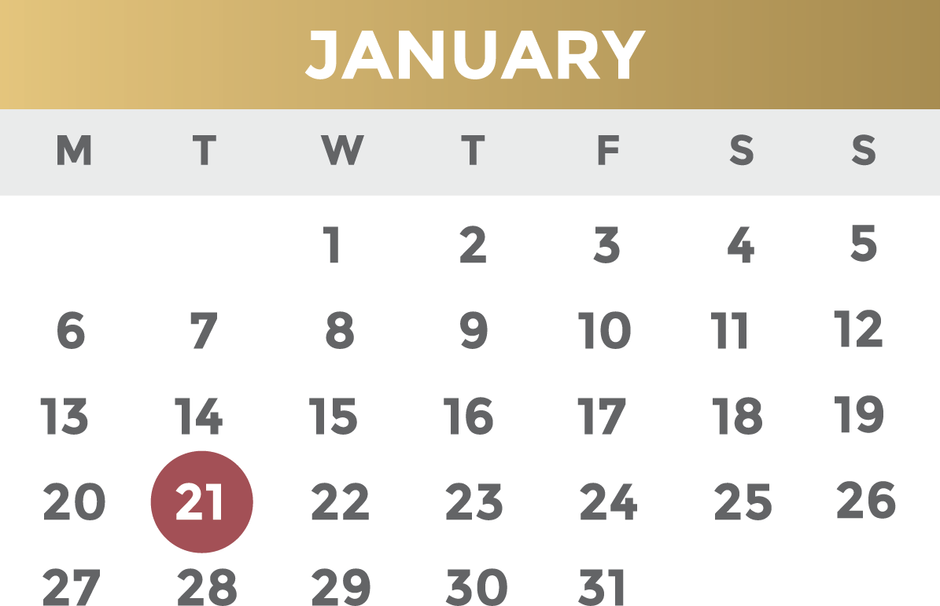
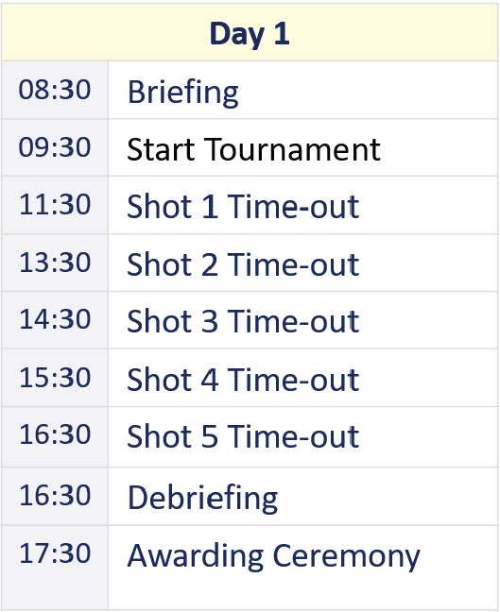
TOURNAMENT
Schedule
A typical 1-day, 5-shot Tournament schedule is:
This can be extended to a few days and less or more shots and customised to specific needs.
9

Slide 10
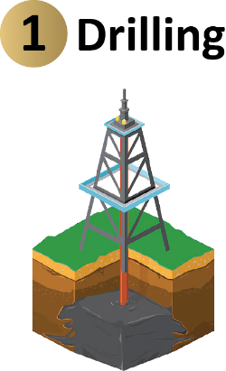
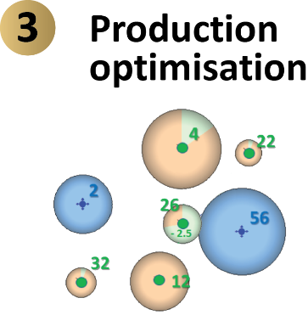
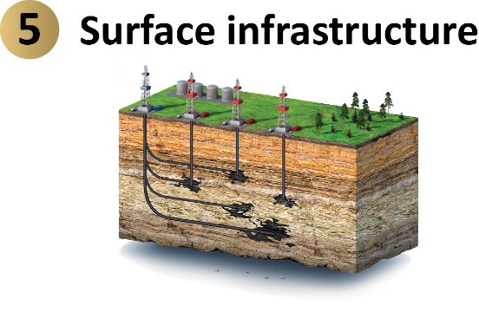
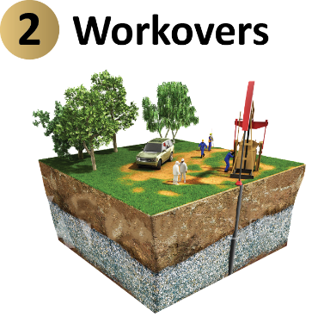
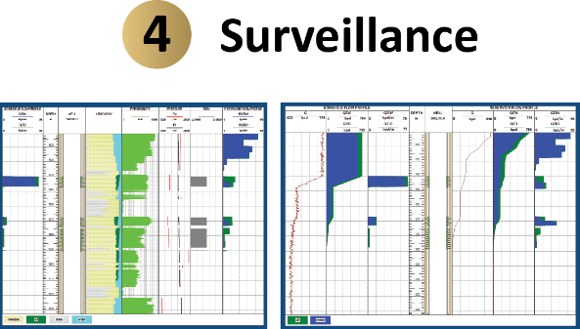
SHOT
Field Operations
The Tournament consists of Shots with the following activities:
Building/Modifying surface facilities
Drilling
Side-Tracks
Workovers
Lift settings for producers
Choke settings for injectors
Seismic survey
Open-hole logging
Cased-hole logging:
Well testing:
Production Analysis:
Production Logging
Corrosion Logging
Leak Detection
BUS/FOS
Multi-rate
Interference Test
Formation Testing
Prime Analysis
Material Balance
RTA/MRT
10

Slide 11
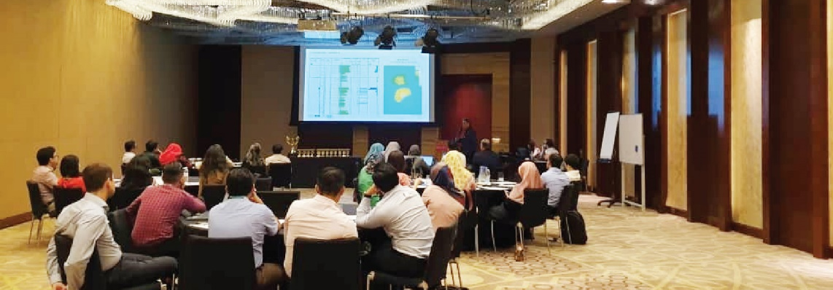
DEBRIEFING
Performance Analysis
Debriefing is the analysis of session performance based on video-presentations and auto-generated performance metrics.
It helps understand the true properties of the asset which were initially undisclosed and compare it with what participants have managed to reveal.
It also helps to understand the efficiency of teams actions by comparing the key performance indicators to those of the Reference Production Scenario and to the other teams.
Debriefing can be performed autonomously by each team or can be facilitated on-line or face-to-face by Nafta College specialist.
11

Slide 12
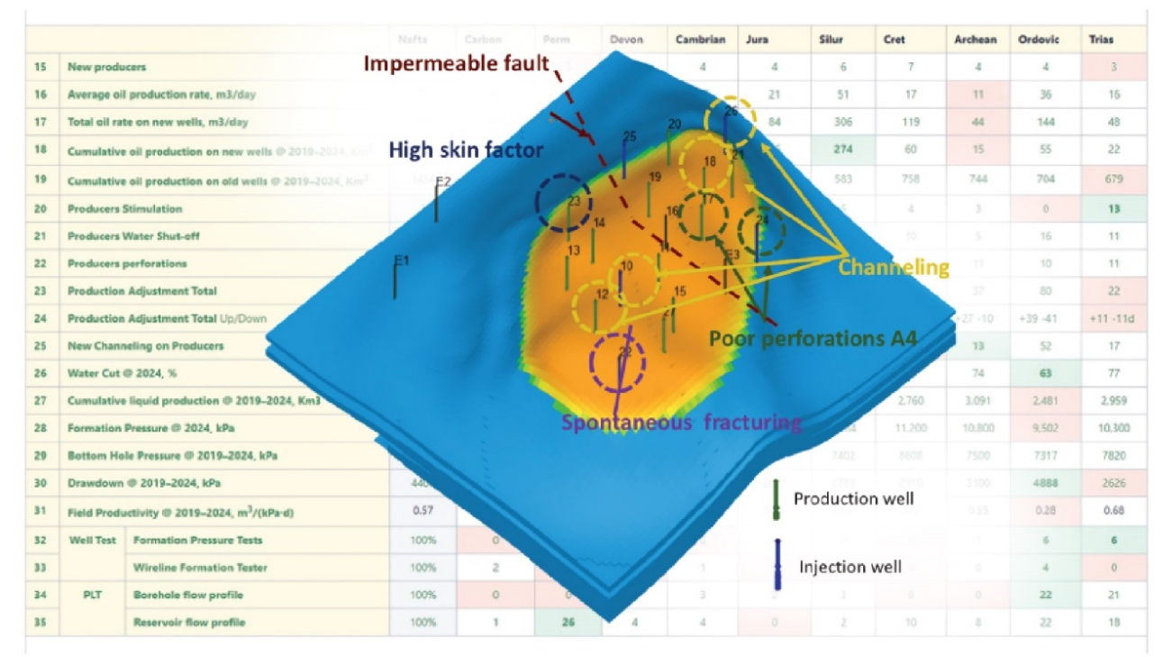
DEBRIEFING
Formats
OMR (Open Map Review) is an online video presentation, explaining the actual Asset properties and performance/complication of each Asset node
CAS (Consolidated Activity Statistics) is a set of autogenerated on-line metrics on team performance which explain the field development strategy each team undertook during the Tournament
AAA (Activity by Activity Analysis) is a set of autogenerated on-line metrics explaining the performance of each and every action which team undertook at each Shot. It is available as online video for the Reference Production Scenario and as a web-presentation for each of the Tournament Teams.
12

Slide 13
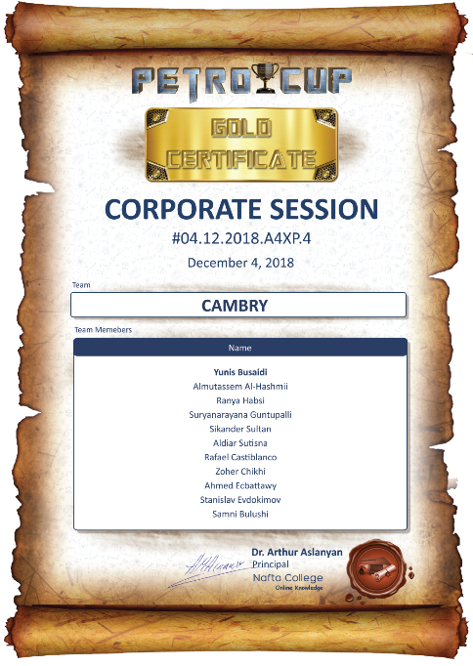
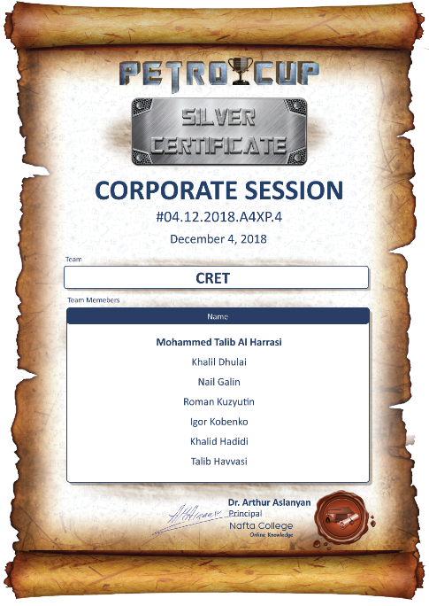
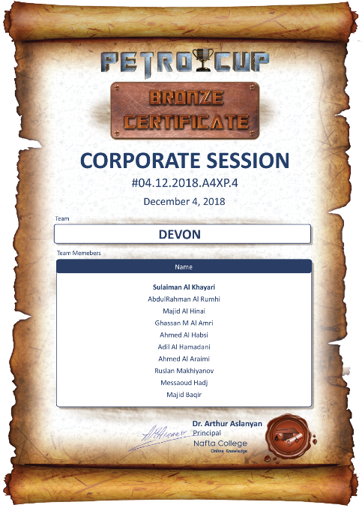
TESTING
Certificate
PetroCup program provides the Certification mechanism by running a one-day 5-shots PetroCup Tournament on a face-to-face basis in one of Nafta's Certified Centres. The PetroCup Certificate can be verified any time in future on-line at Nafta website.
The Certificate sessions provide the unbiased automated assessment of practical skills in key petroleum and management disciplines including the:
• Field Development Planning
• Geology, Geophysics and Exploration
• Well and Reservoir Management
13

Slide 14
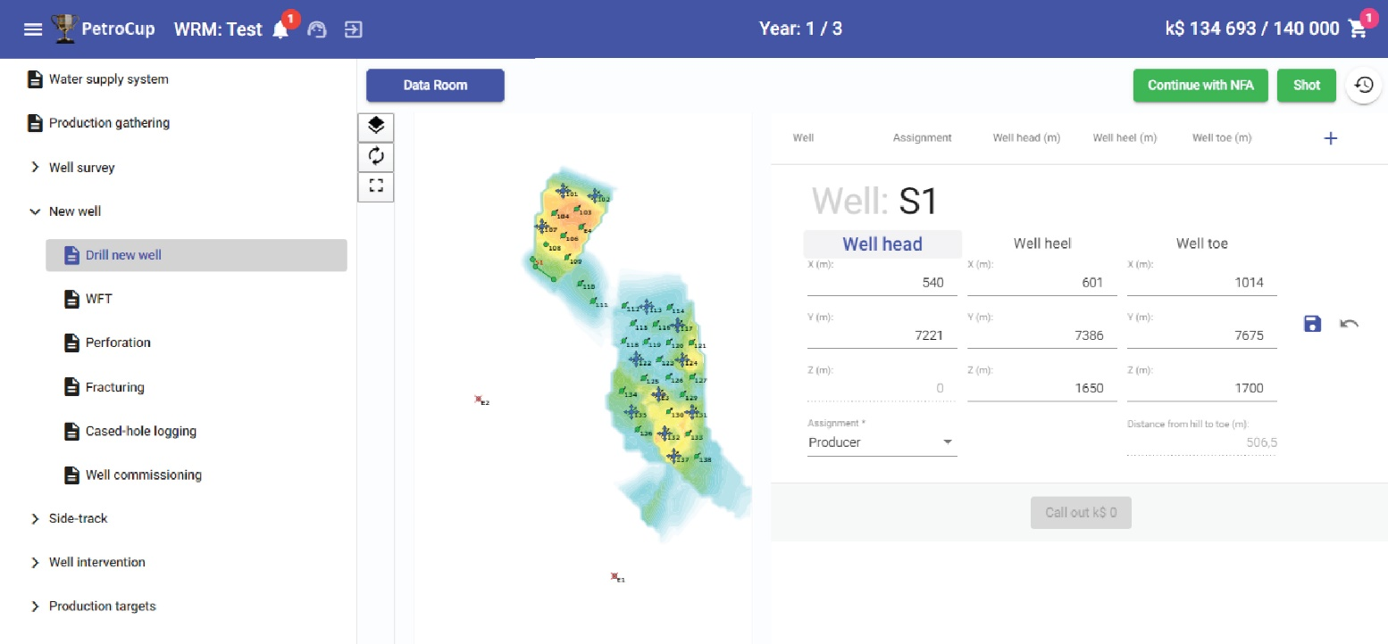
TOOLS
PetroCup
PetroCup software implements a digital twin of Petroleum Asset, replicating the behaviour of:
Various Asset facilities
Various Asset Activities
Asset Economics
rocks, reservoirs, wells
surface pipelines, pumps,
processing plants
drilling, workovers, well completions
lift settings, surface pumps and pipelines
well & pressure tests
open-hole and cased-hole logging, tracers
Net Present
Profit Value
Profit And Loss
Cash Flow
Balance Sheet
Various types of flows through the Asset facilities
Procurement & Contract Logistics
14

Slide 15
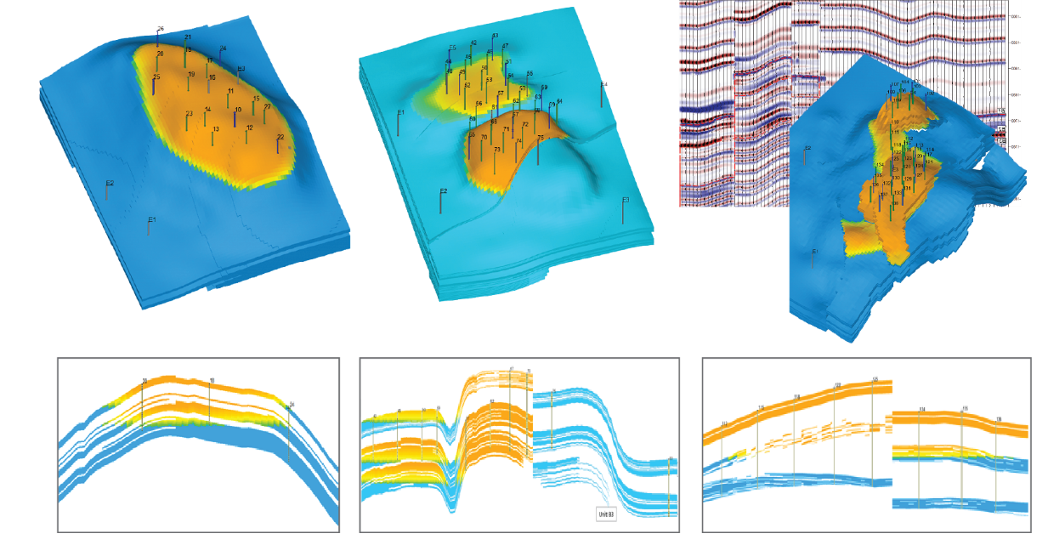
ASSET RESOURCES
Petroleum Assets Library
Saturated fields
Undersaturated fields
Gas fields
Bottom-water and edge water
High to Low permeability
High to Low viscosity
On-shore & Off-shore
15

Slide 16
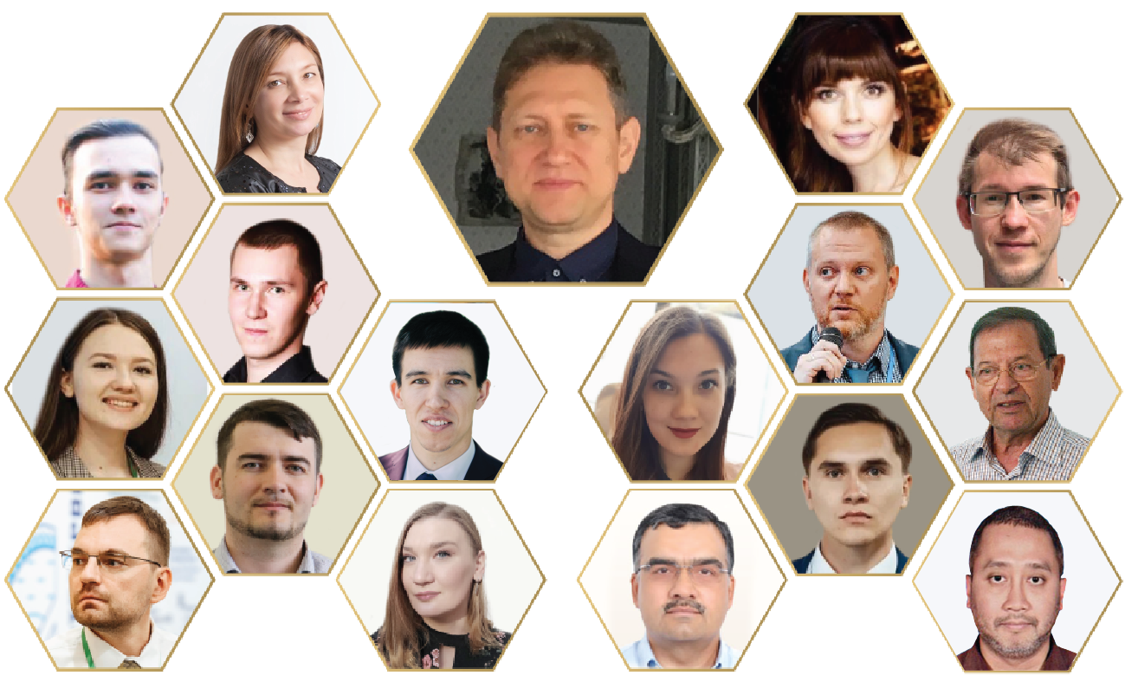
HUMAN RESOURCES
Nafta Team
Nafta is proud to have a strong international multi-disciplinary team of industry specialists who create synthetic assets and realistic production scenarios from accumulated worldwide experience.
They also perform training, master-classes and moderate PetroCup sessions.
16

Slide 17
Thank you!

